Slide 1

University Workshop Series
Power Platform and AI Builder
Glendon Thaiw, Technology Specialist (Azure & Bizapps)
Notes:
Hey everyone - I'm Glendon, a Technology Specialist with the Microsoft Azure and Business Applications team in Singapore.
Welcome to the University Workshop Series – where we aim to introduce the interesting suite of Microsoft products and how we can make use of different tools to accelerate our personal projects – be it on school assignments or for work projects.
As the second workshop of our 3-part series, I will be bringing you through the world of the Microsoft Power Platform and AI Builder, and see how we can tap on low-code and no-code services to build equally capable applications and products.

Slide 2
Agenda
TRANSFORMATION ENABLERS
Introduction to Microsoft Power Platform and AI Builder
(10 mins)
Building Models with AI Builder
(10 mins)
- Object Detection Model
- Form Processing Model
Building Canvas Apps
(40 mins)
- Online Shopping Assistant Application
- Form Processing Automation Application
Workshop Resources
(5 mins)
Notes:
I have designed the workshop to be as follows for the next hour.
To kickstart the session, I’d begin by introducing what exactly is Microsoft Power Platform and the different services that it entails. I will briefly go through components such as the AI Builder and the Microsoft Dataverse – as we’d be using them for the later parts of the workshop.
After we get the theory out of the way, we’d jump straight into the Power Platform portal and start building.
We will begin by building 2 AI models – the first one is an Object Detection Model that takes in images of different green teas and is able to identify and reconogise the type of green tea that it perceives. Secondly, we will build a form processing model that is trained to extract certain entities within a sales invoice that we want, and is able to do so on a completely new invoice document.
After building the AI models, we will put them into good use by building 2 separate mobile and tablet applications that leverages on the model to introduce AI capabilities into our use-case.
I will then end off the workshop by going through some of the helpful resources that I have prepared that is relevant to the workshop today.
Without further ado, let’s begin!

Slide 3
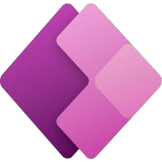
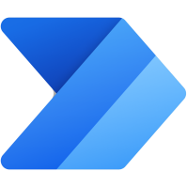


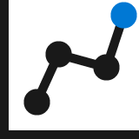
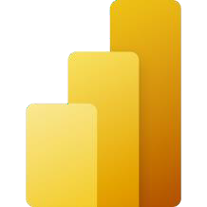



Power Platform: Everyone’s platform for transformation
Power Apps
Drive business processes
Improve engagements with customers and employees
No Code
Drag and drop experiences that are like PowerPoint
Power Automate
Power Virtual Agents
Low Code
Drag and drop plus Excel-like formulas for functionality
Automate response metrics
Analyze data from apps and bots
Power BI
Code First
Professional development and extensibility across Microsoft
AI Builder
Dataverse
Data Connectors
Management Tools
Notes:
So, what exactly is the power platform?
The Power Platform is a group of products by Microsoft to develop and build complex business solutions, analyze and draw data visualizations, automate a business process, or build virtual agents for communication.
All these products offer a platform in which no code is required to build the applications.
These products are in the form of simple graphical user interface which can be used by any business users or citizen developers
The Microsoft power platform is made up of 4 main products: We have the
1) Power Apps are used to build powerful mobile apps and web apps for internal and external uses
2) Power Virtual Agents are used to develop flexible chatbots that can communicate with external customers
3) Power BI are used to analyze data from different data sources and build interactive dashboards
4) Finally, Power Automate is used to design automated workflows to reduce manual tasks.
Using the native integration between the 4 products, we can build sophisticated solutions to solve complex business problems without having to write a line of code.
Microsoft is also constantly adding additional capabilities to the Power Platform to improve its realms of possibilities and range of use-cases.
An example is the AI Builder, which allows us to bring the power of AI through a point-and-click experience, so we don’t need any coding or data science skills to access the power of AI into our apps and services.
As we can see – there are simply too many components to the Power Platform to cover within a one-hour workshop. Hence, we’d be focusing our time on building applications with Power Apps, building AI models without code with AI model – and finally leveraging Microsoft dataverse as our database layer for the solution.
------------------------------------------------------------------------------------------------------------------------------------------------------------------------------------------------------
Brings together 4 services to increase drive business value and increase ROI
to drive business processes through Power Apps, improve engagements with customers and employees through Power Virtual Agents, analyze data from apps and bots through Power BI and automate response metrics to drive business processes through power automate
All built on and supported by Dataverse which allows for external data connectors and in-built AI builder
As well as management tools to manage the current systems

Slide 4








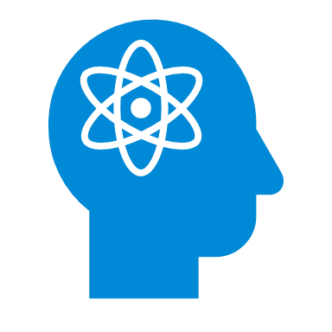


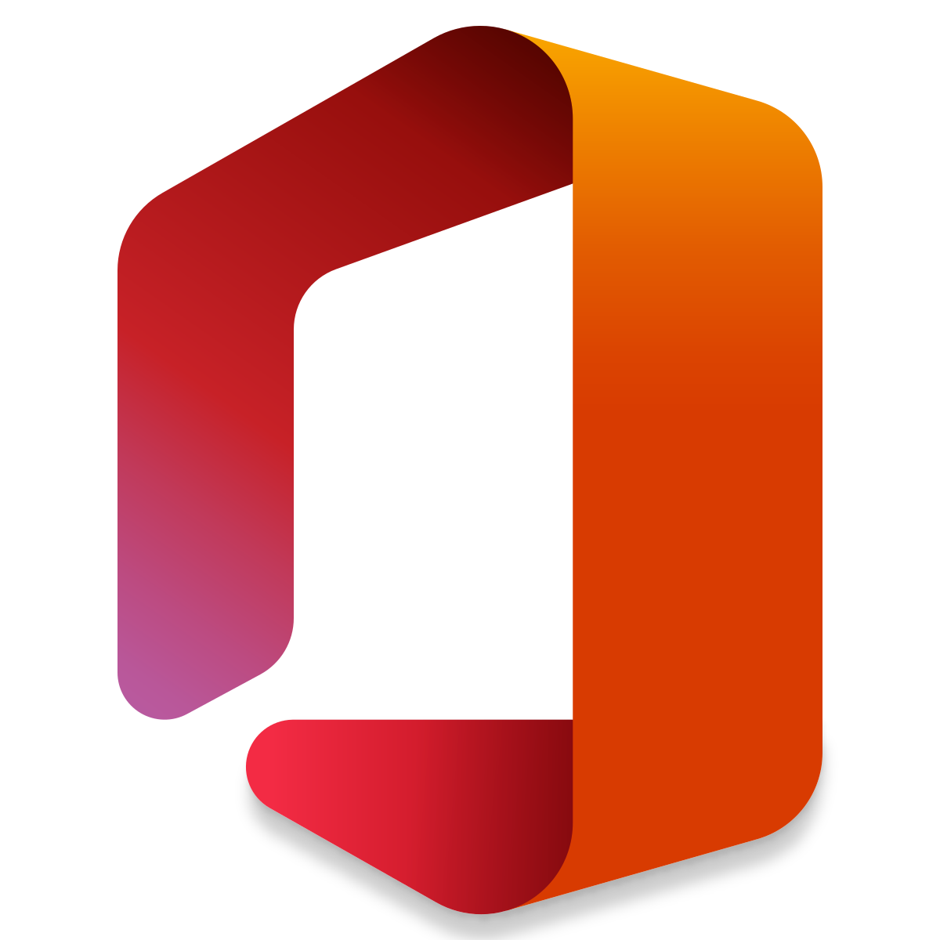
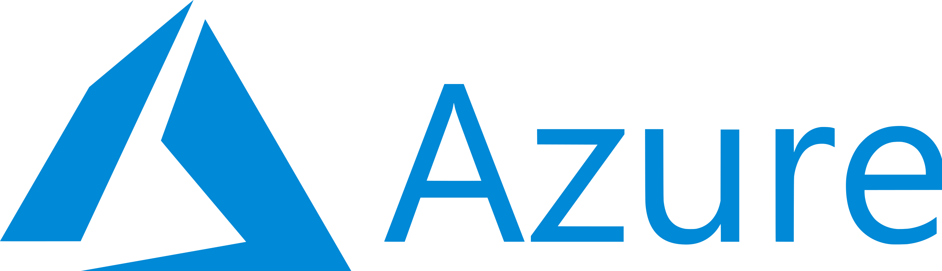




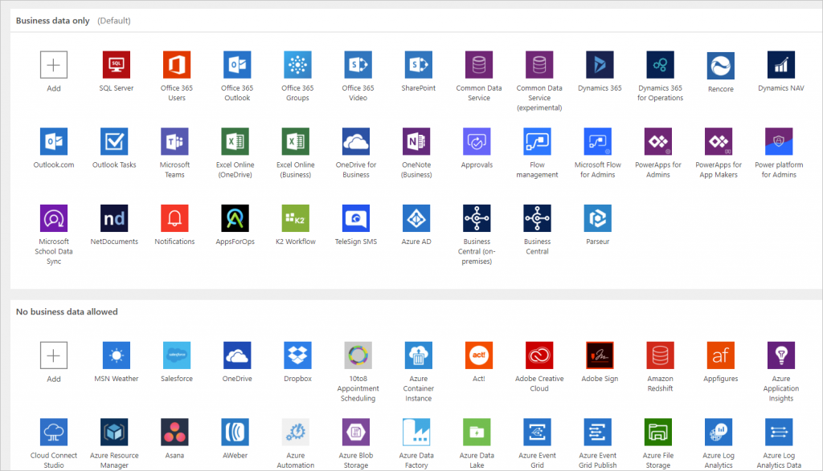
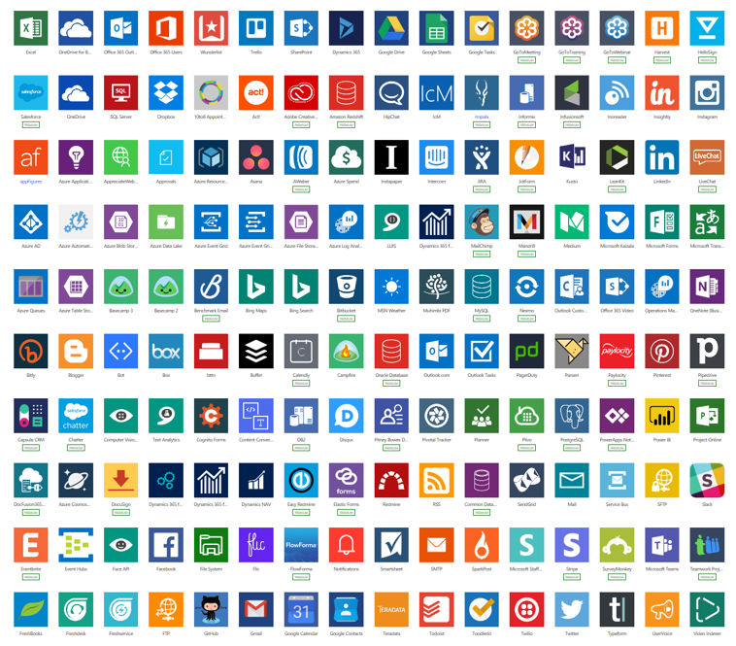
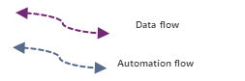
Anatomy of a Power Platform
Internal Users
Other roles + Targeted Roles
Internal Users
Targeted Users
External Users
Suppliers, Customers, Providers,
Embed Apps and Analytics
Cognitive
Experience
Measures
KPIs
Model Driven Apps
Dynamics and Non-Dynamics Apps
Canvas Apps
Portals
Power Virtual Agents
Search
Power BI
Business analytics
Power Apps
Application development
Language
Security
Knowledge
Business Unit / Sub BU / Teams
Services
Policy Management (DLP, Use, Share, …)
Hierarchical
Azure AD Based / Organization Wide
Field Level Security
May use
Common Data Service
Triggered, on-demand or recurring
AI Builder
Speech
Power Automate
Process automation
Office
Apps
Data and Integration
Use
Use
Labs
Data connectors
Vision
Business Non-Business Custom
Extend
External
Systems
Notes:
The coolest part about the Power Platform lies in its flexibility and ability to integrate with other products and services within the Microsoft suite or third party tools.
The purpose of this slide is to give you a pictorial understanding of the modularity of the Power Platform – and how we can pick and choose different services within the platform depending on our unique needs.

Slide 5


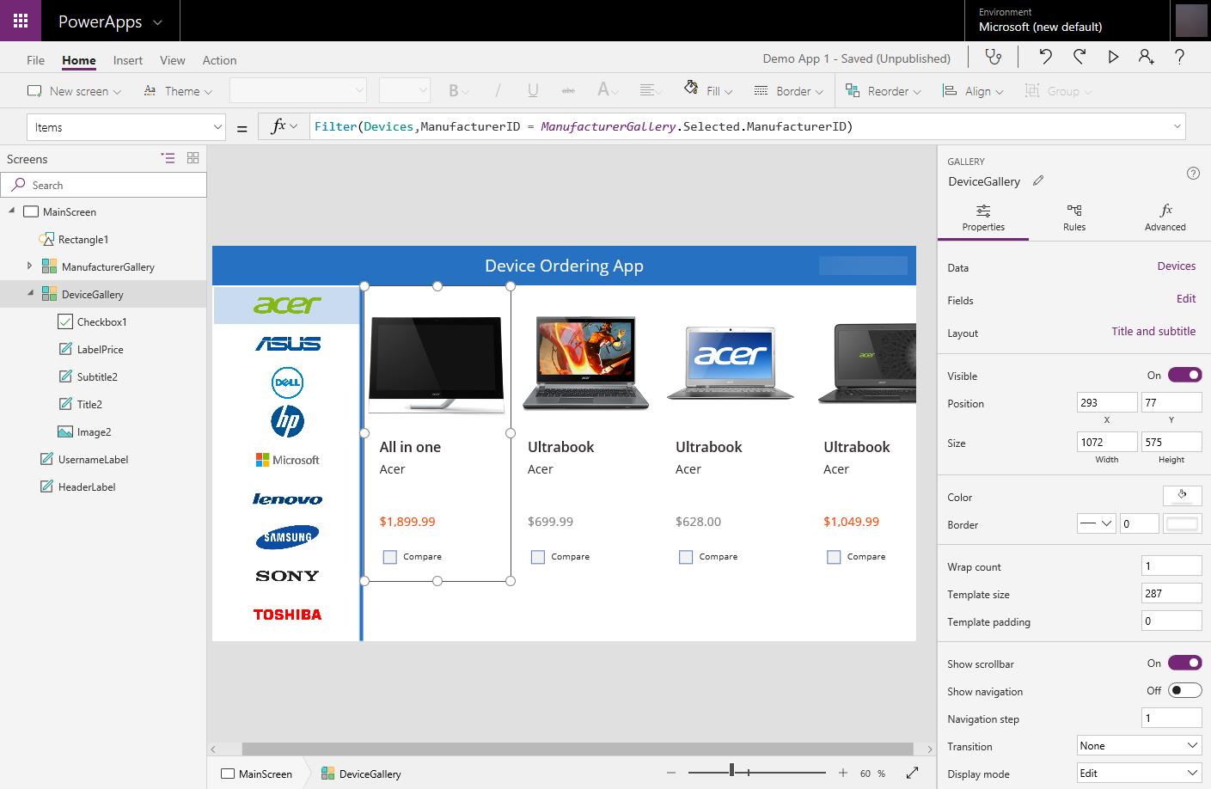
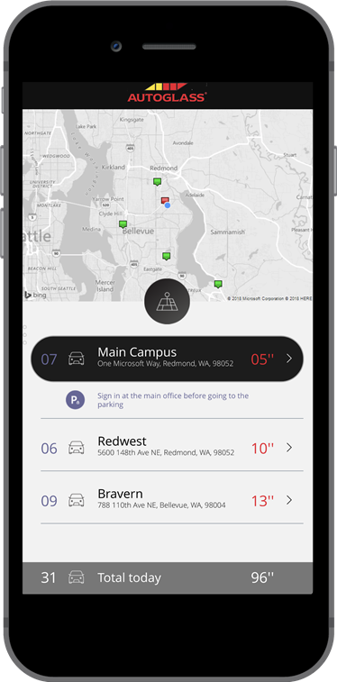
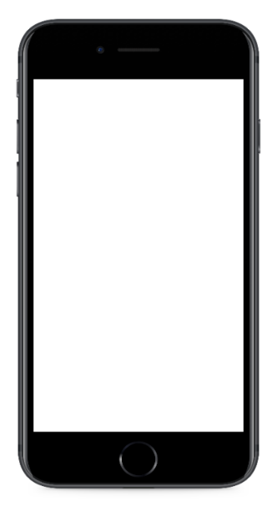
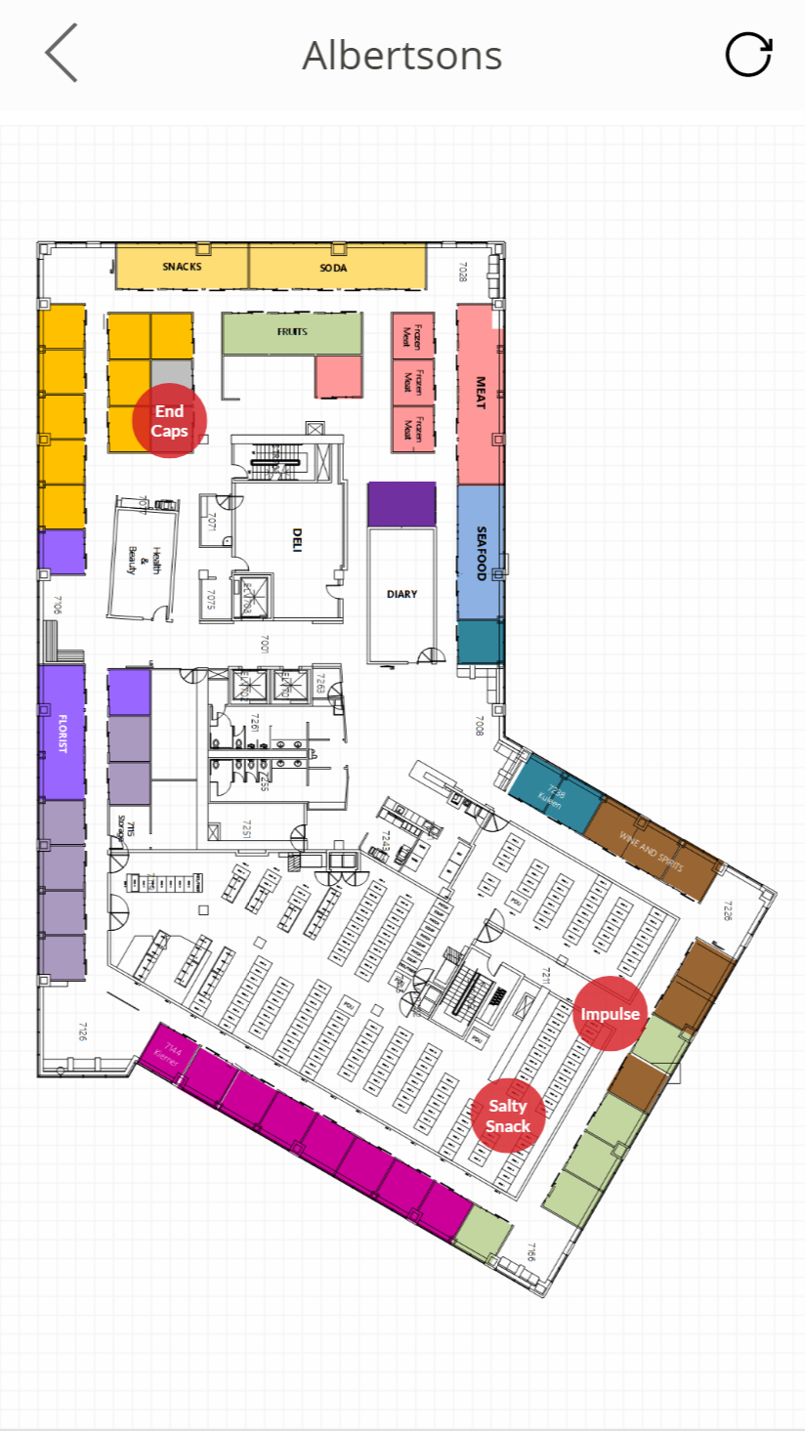
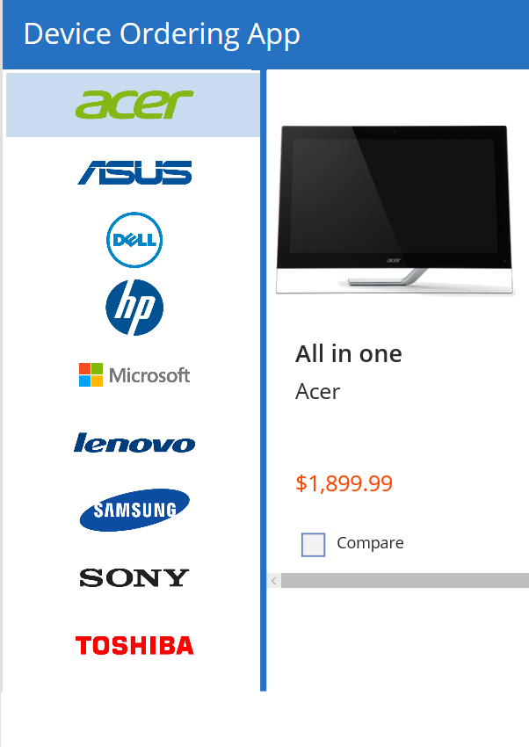
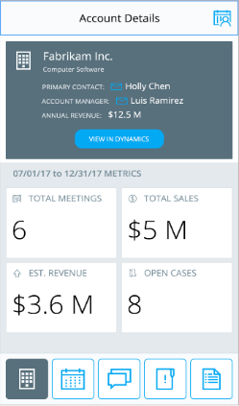

Power Apps: a low-code approach to build mobile apps, desktop apps and web portals
Easily build web & mobile apps with a full featured low-code / no-code platform.
Combine PowerPoint with Excel = Power Apps!
Add mixed reality experiences to your apps
Connect to your existing data with 450+ pre-built connectors and custom connectors
Leverage device features such as camera, GPS, microphone and pen & ink with no code!
Business users solve business problems. Partnering with Pro-dev’s to extend and integrate. No limits.
Integrates with Microsoft Teams, Office 365, Azure, Dynamics, Power Automate & Power BI
Strong enterprise governance & security
Notes:
Zooming in to the first component that we’d be focusing on today, we have the Microsoft Power Apps
As the name suggests, Microsoft Power Apps is a service that provides a rapid development environment for us to build custom apps for our different needs.
Its biggest selling point lies in the fact that we are able to build fully production-ready applications using a low-code or no-code approach through the Power Apps studio. If you’re familiar with Powerpoint or Excel – which I believe most of us are; you should be able to feel right at home with Power Apps. And why is that so? It’s because
Building visual or UI components can be easily done in a similar fashion to building slides on Microsoft Powerpoint and
Introducing and writing business logic to different components can again be done through a similar fashion to writing formulas on Microsoft excel
On top of all that, we are able to leverage on existing data sources and connectors and connect them to our applications. As we are building mobile applications, we can capitalise on device features such as camera, GPS, microphone and the pen & ink feature all with no code.
Finally, we can extend the usability of our application to the suite of Microsoft and 3rd party products to further create intricate solutions and to solve complex business problems. What we’d be doing later is to introduce the capabilities of machine learning into our Power Apps as an integrated solution.
What is Power Apps? - Power Apps | Microsoft Docs

Slide 6
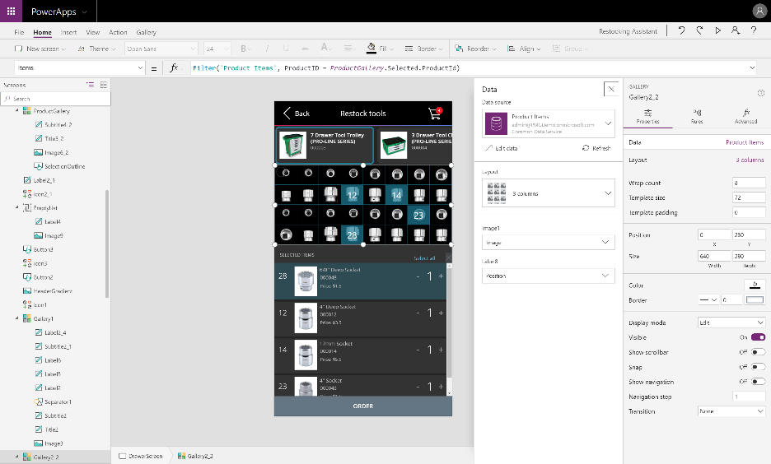
Power Apps Studio
Authoring experience for creating Power Apps
7
Always updated with the latest builds and allows you to work in your browser
4
6
5
1
Left navigation bar
Middle pane
Right-hand pane
Properties
Formular bar
Ribbon
Additional items
2
3
Notes:
The application development process with Power Apps will take place within Power Apps Studio which allows you to work in your web browser. This allows us to build apps from our laptops or tablets, anytime and anywhere.
This is also where we will be spending the bulk of our workshop on – as we start building our canvas app in a couple of minutes.
---------
This slide ill
If all of them don’t fit to your needs, configure it further with the Canvas apps authoring experience
Start with your data
Start with a blank canvas
Start with a template

Slide 7
AI Builder Low-code AI for apps and processes
Low-code AI solutions for Power Platform leveraging the power of Azure AI.
Native integration with Common Data Service enables data from CDS, Azure Data Lakes.
Leverage predictions directly from Common Data Service across your Power Platform solutions, Dynamics 365, or Microsoft 365.
Prediction
Vision
Vision
Language
Binary classification
Predict and classify fields in CDS.
Forms processing
Extract structured data from digital paper, PDFs, and forms.
Object detection
Detect any object (via custom training) through camera or image control.
Text classification
Classify, group and categorize any text in CDS.
Notes:
Moving forward, we will talk about the next biggest component of today – the AI Builder.
In line with the Microsoft Power Platform design language, AI Builder is a low-code/no-code AI solution that we can tap on to add AI capabilities to the applications we build. This enables makers to automate tasks and predict outcomes without having to involve data scientists.
Some out-of-the-box AI use-cases are Prediction models for binary classification such as predicting whether a lead will turn into a sale in a sales dataset,
Form processing model to extract datapoints from structured data such as digital paper, PDFs and forms,
Object detection models that detects objects from an image or photo captured,
And text classification that performs categorization on unstructured text data to give you an insight on the data collected. This is extremely useful when analyzing customer feedback on a public facing website.
What is AI Builder? - AI Builder | Microsoft Docs

Slide 8
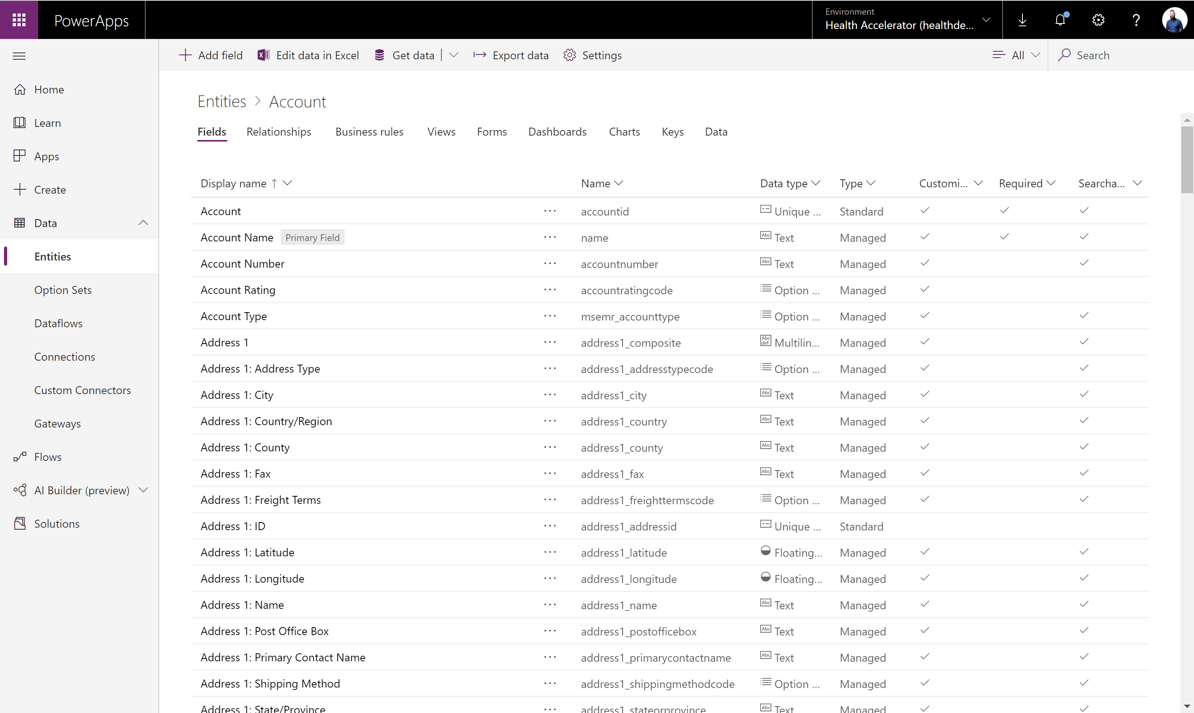

Dataverse Put all your data to work
Jumpstart apps using an extensible data model with business logic, security and integration built in.
Extend data and processes to external and anonymous users with Power Apps portals.
Support all your data: relational data, file and blob storage, logs and search indexing.
Effortless Dynamics 365, Office 365 and Azure integration as well as powerful integration capabilities.
Notes:
Lastly, we will briefly talk about Microsoft Dataverse, or formerly known as the Common Data Service.
As with all application development environments, we will need a secure and most importantly scalable way to store and collect different data associated with our apps.
Microsoft Dataverse aims to do just that. It is a mature data platform that has native integration with the Microsoft suite from the Power Platform, Office 365, Dynamics to Azure. That means whether you’re building business applications on Power Platform or scaling your Azure container clusters, you’d be able to tap onto the same data at the same time.
For those who are familiar with databases, this would serve as a relational database and allow us to easily index common data types such as excel or CSV files.
In this workshop, we will start by initializing a couple of tables at the start of the demo to be used during our application development process.
-----------------------------------------------------------------------------------------------------------------------------------------------------------------------------------------------------------------------
A mature data platform to manage data used by business applications, CDS is the platform that sits under the Dynamics 365 Sales, Service and Marketing business applications and is offered as a service to the Platform. An initial schema is defined by the Common Data Model. CDS provides built-in capabilities for business rules, workflows, calculated and rollup fields and more. CDS secures data using a configurable security model, that offers hierarchical, row level and field level security and auditing capabilities.
The Common Data Service (CDS) is a mature data platform used to securely store data for business applications built on Power Apps. CDS is an abstraction on top of underlying Azure cloud data management services to make it easier to build business applications. CDS provides not just data storage, but a way to implement business logic that enforces business rules and automation against the data. Data in CDS is organized as entities, for example account and contact would be two examples of entities. These entities can have relationships that define the business connection between the data stored in an entity. For example, John is the primary contact for Contoso would be expressed as a relationship from account to contact. The security model of CDS enables data protection down to the field level on individual records. A more thorough discussion of security will be covered in the security section of this paper.
CDS databases are created in the context of a Power Platform environment. Each environment can have only a single CDS database. CDS databases can be provisioned by you or licensed individuals in your organization to support their custom applications. A CDS databases is automatically provisioned when a Dynamics 365 Customer Engagement application is added to your tenant. The CDS language and currency settings cannot be changed afterwards, enterprise organizations that operate in multiple regions should align on a base language and base currency.

Slide 9
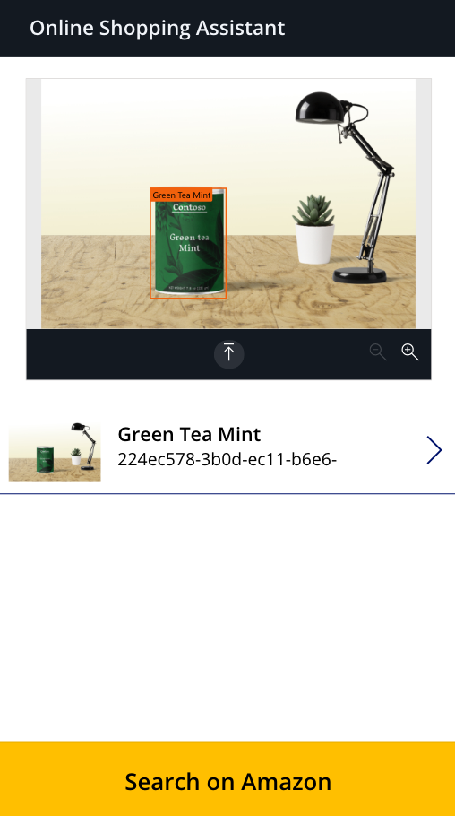
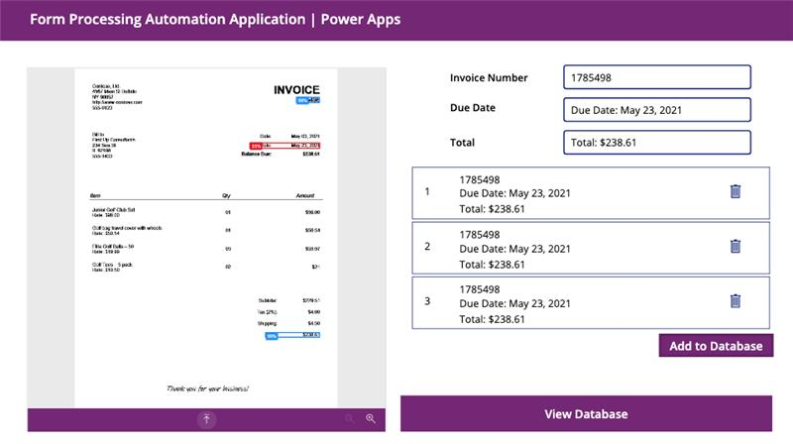
Hands-on Workshop Overview
End Product Showcase
Online Shopping Assistant
Object Detection AI model
Form Processing Automation Application
Form Processor Model / Optical Character Recognition (OCR)
Notes:
Now with all of the theory out of the way,
We will get to the exciting part – which is the hands-on workshop.
By the end of the hour, we would have built two canvas applications powered by AI.
The one on the left is an Online Shopping Assistant mobile application that uses the camera function to capture a photo or uploads an image to an Object detection AI model. The AI model will return the objects identified in the image, and allow us to select it to search on Amazon. As we click on the button Search on Amazon, we would be directed to a page on Amazon that sells the same item that we have selected on the mobile app.
On the right, we have a tablet application instead that has the ability to perform form processing automation on a large set of digitalized papers and PDF documents. With the application, we can easily upload a file or document of a sales invoice, perform form processing with the AI model we built to extract the relevant information that we want, and index them into a database such as dataverse.
And with that, let’s start building!
I’d start by navigating to the Power platform portal…

Slide 10
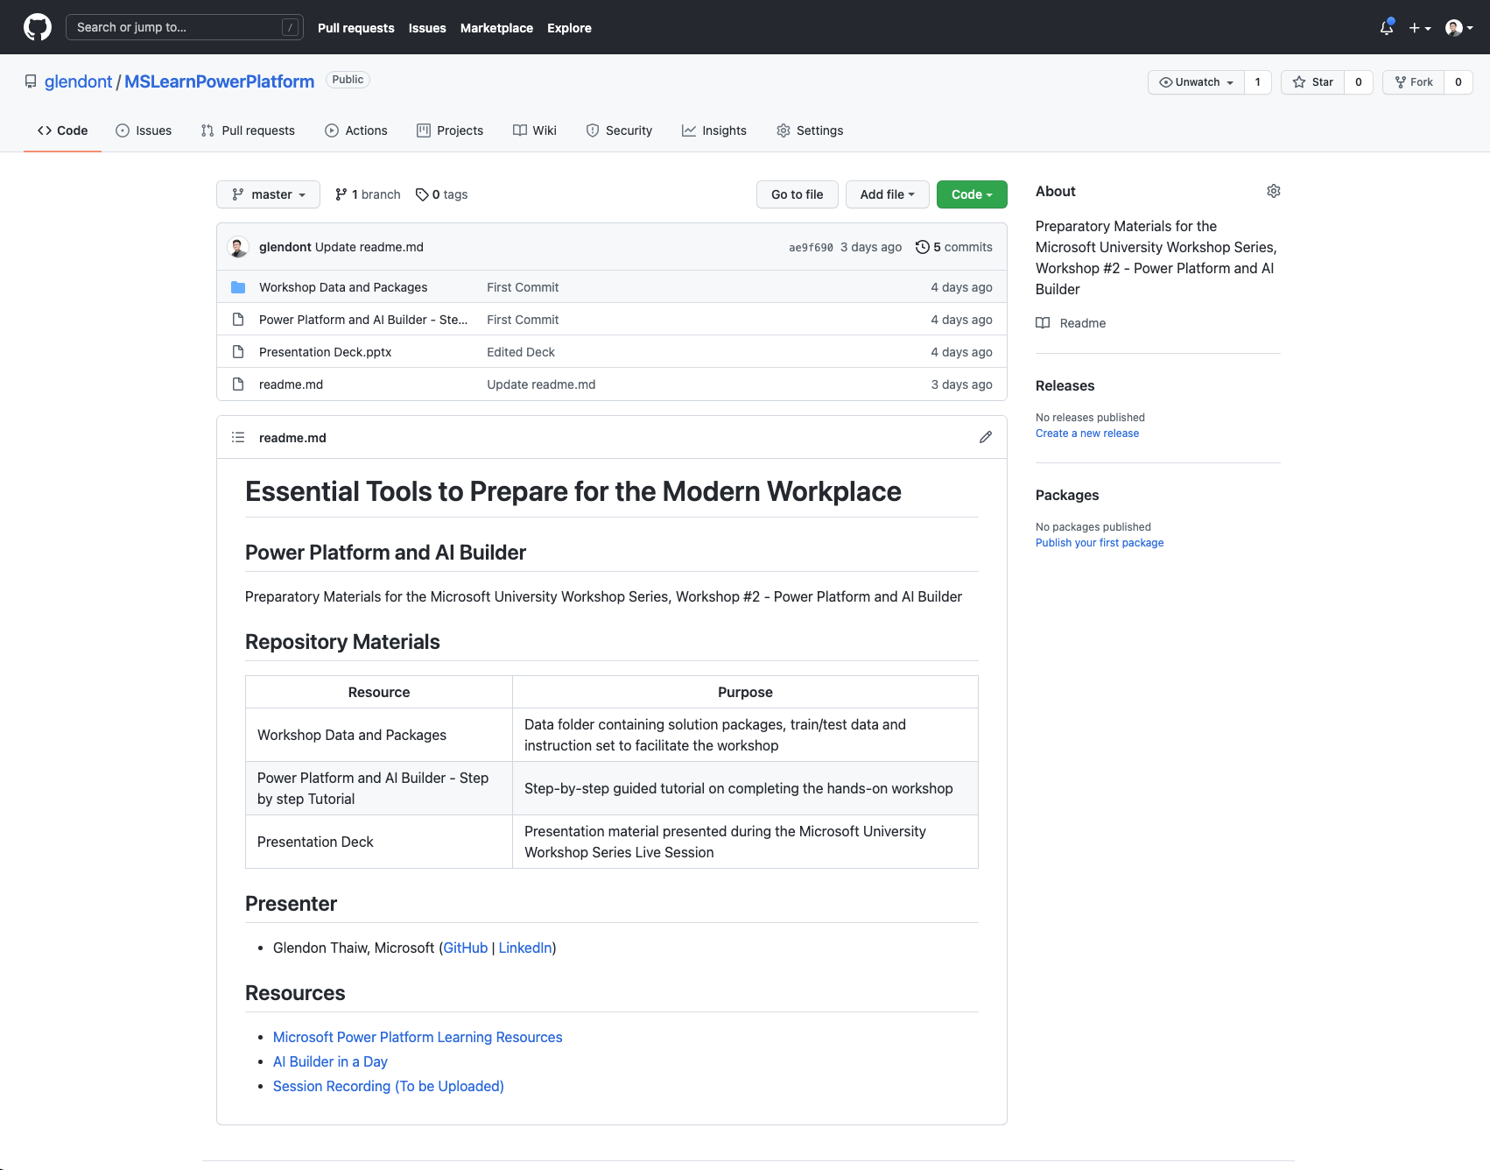
Workshop Resources
Hands-on Training Lab Overview
https://github.com/glendont/MSLearnPowerPlatform
Notes:
Now as I come to the end of the workshop, I’d like to share some helpful resources that I have prepared for this workshop.
In this public Github repository, you can access this deck of slides, workshop solution files, sample data and images that we have used earlier.

Slide 11
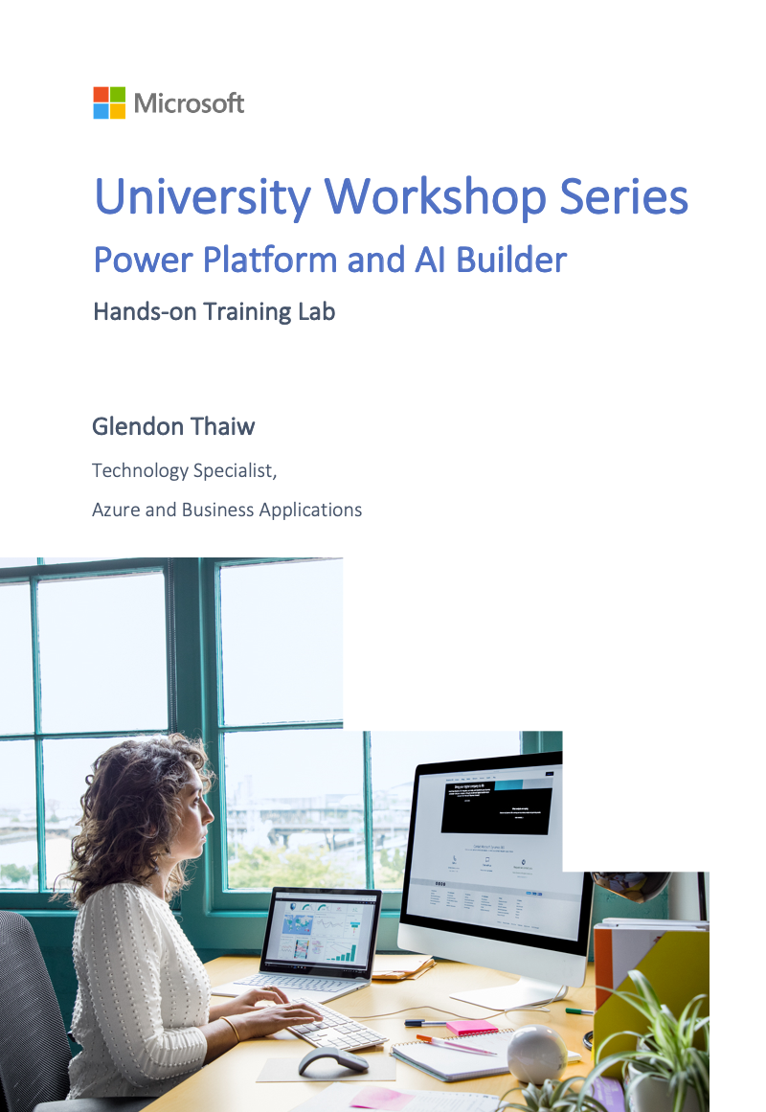
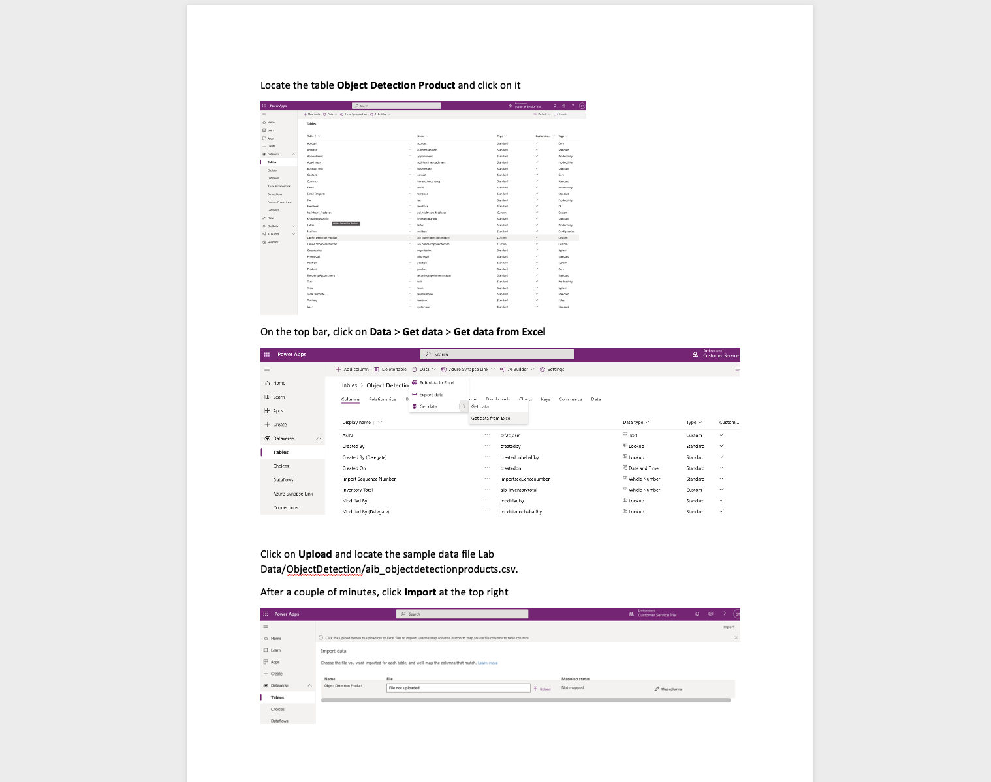
Workshop Resources
Hands-on Training Lab Overview
Notes:
Most importantly, I have also prepared a step-by-step guide in the form of a word document that takes you through what we did earlier to build the 2 power applications. If you’d need to refer to it or pass it forward to a friend, please feel free to do so.
The live recording of this session will also be uploaded onto the repository at the soonest for your viewing and reference after the workshop.

Slide 12
Questions and Answers

Slide 13
Notes:
With that, I have come to the end of workshop 2 of the University Workshop Series – I hope you have gained value out of this session.
If you need any help, please don’t hesitate to reach out to me through Linkedin.
Thank you so much for your time and have a great day ahead – see you guys!

Slide 14
Dataverse Implements the Common Data Model (CDM)
CDM SCHEMA
App1
App2
AppN
Core
SALES
SERVICE
SOLUTIONS
Education
Account
CRM
Account
Competitor
Case
MARKETING
Activity
Appointment
Discount
Discount
Account
Contact
Campaign
Invoice
Contact
Contact
Currency
Contact
Opportunity
Resource
Event
Email
Lead
Order
Service
Marketing email
Goal
Marketing list
Order product
Scheduling group
Automotive
Healthcare
Letter
Phone call
Quote
Task
Marketing page
Microsoft Dataverse
Note
Social activity
…
…
…
Owner
…
Organization
Position
WEB
TALENT
TALENT
Task
Link Clicks
Department
Patient
Risk assessment
Medication
Financial Services
Web interactions
Job position
Practitioner
Encounter
Procedure
Nonprofit
Web page
Worker
Device
Episode of care
…
…
…
Care plan
ACCOUNT
ATTRIBUTES
Data source1
Data source2
Data sourceM
Description: Business that represents a customer or a potential customer
Account number
Account rating Code
Created on
Credit limit
Open deals
Open revenue
Territory id
Hotel group
Open source and shared data model that provides semantic consistency for data
Allows makers to more quickly develop applications and integrators to more easily interoperate across multiple systems
A growing set of solutions and partners that contribute to the effort by implementing CDM or extending with industry-specific domains
Notes:
An initial schema is defined by the Common Data Model on Microsoft Dataverse.
The common data model simplifies data management and app development by unifying data into a known form and applying structural and to ensure consistency across multiple apps and deployments

Slide 15
Unlock more with Microsoft Power Apps Power Apps combines a simple visual approach with advanced tools, making it easier for everyone to build better apps more efficiently
Get to better solutions faster
Enable employees to build and launch their own apps to address their own business challenges – with nothing to slow them down
Make better use of resources
Free up limited pro dev resources and enable them to work faster on mission critical apps and enterprise wide solutions
Optimize existing investments
Build apps that integrate seamlessly with your Office 365, Dynamics 365 and Azure tools and data
Drive business value and increase ROI

